Slide 1



SAPTHAGIRI COLLEGE OF ENGINEERING (Affiliated to Visvesvaraya Technological University, Belagavi & Approved by AICTE, New Dehli) Department of Computer Science & Engineering
Presentation on :- Presented By:-
Fake Job Prediction Swapnil 1SG18CS119
Using Machine Learning Pranav Parth 1SG18CS072
Rishu Raj 1SG18CS085
Ritik Saini 1SG18CS086
Under the Guidance of:
Prof. Latha A
Associate Professor,
Dept. Of CSE, SCE
2021-22

Slide 2
Contents
Overview of Phase 1 Review
1
2
Abstract
Problem Statement
3
4
Literature Survey
Objective
5
6
Architecture
7
Proposed System
8
References

Slide 3

Overview of Phase 1 Review
The early phase detailed the motivation and reason behind to choose the topic
Review 1 gave the general idea of project abstract and how can problem statement be solved with scope and outcome
Review also put light on existing system and what new we are going to achieve and what methodologies a\we are planning to implement

Slide 4
Abstract
Employment scams are on the rise. According to CNBC, the number of employment scams doubled in 2018 as compared to 2017. The current market situation has led to high unemployment. Economic stress and the impact of the coronavirus have significantly reduced job availability and the loss of jobs for many individuals. A case like this presents an appropriate opportunity for scammers. Many people are falling prey to these scammers using the desperation that is caused by an unprecedented incident. Most scammer do this to get personal information from the person they are scamming. Personal information can contain address, bank account details, social security number etc. I am a university student, and I have received several such scam emails. The scammers provide users with a very lucrative job opportunity and later ask for money in return. Or they require investment from the job seeker with the promise of a job. This is a dangerous problem that can be addressed through Machine Learning techniques and Natural Language Processing (NLP).

Slide 5

Problem Statement
This project aims to create classifier that will have the capability to identify fake and real jobs.
The final result will be evaluated based on two different models. Since the data provided has both numeric and text features one model will be used on the text data and other on numeric data.
The final output will be a combination of the two. The final model will take in any relevant job posting and produce a final result determining whether the job is real or not

Slide 6
Literature Survey
Sl.No. | Title | Author | Publisher | Description | Methodology | Advantages
1. | Detecting Online Recruitment Fraud Using Machine Learning | Hridita Tabassum; Gitanjali Ghosh; | IEEE(2021) | In this paper, publisher proposed a solution on how to detect ORF. They presented results based on the previous model and the methodologies, to create the ORF detection model where they used own dataset. They have created own dataset based on the Bangladesh job field and by using a publicly accessible dataset as a reference. | Logistic Regression, AdaBoost, Decision Tree Classifier, Random Forest Classifier, Voting Classifier, LightGBM, Gradient Boosting are the algorithms that have been used. | Accuracy of different prediction models, where LightGBM (95.17%) and Gradient Boosting (95.17%) give the highest accuracy.

Slide 7
Literature Survey
Sl.No. | Title | Author | Publisher | Description | Methodology | Advantages
2. | Online Recruitment Fraud Detection using ANN | Ibrahim M. Nasser; Amjad H. Alzaanin; | IEEE(2020) | In this paper, publisher proposed a solution on how to detect ORF. In this paper, an Artificial Neural Network based model is proposed to detect fraud job posts. | The public Employment Scam Aegean Dataset (EMSCAD) is used with proper text preprocessing techniques for training and testing the proposed model. | ANN model has precision, recall, and f-measure of 91.84%, 96.02%, and 93.88% respectively.

Slide 8
Literature Survey
Sl.No. | Title | Author | Publisher | Description | Methodology | Advantages
3. | Fake Job Recruitment Detection Using Machine Learning Approach | Shawni Dutta and Prof.Samir Kumar Bandyopadhyay | IEEE(2020) | Employment scam detection will guide job-seekers to get only legitimate offers from companies. For tackling employment scam detection, several machine learning algorithms are proposed as countermeasures in this paper. Supervised mechanism is used to exemplify the use of several classifiers for employment scam detection. | K-nearest neighbor, Decision Tree classifier, Random Forest Classifier | Accuracy of different prediction models, where KNN has 90% accuracy, Decision tree has 93% accuracy and random forest has 95%accuracy.

Slide 9
Literature Survey
Sl.No. | Title | Author | Publisher | Description | Methodology | Advantages
4. | Fake Job Detection and Analysis Using Machine Learning and Deep Learning Algorithms | C.S. Anita ; P. Nagarajan ; | IEEE(2020) | In this paper, we have applied machine learning and deep learning algorithms to classify and detect fake jobs from real jobs in a large dataset of job posts. Machine learning algorithms such as logistic regression, KNN classifier and random forest algorithm are used for classification purpose. Deep learning algorithm, Bi-Directional LSTM is used to train the neurons for classification. | K-nearest neighbor, Logistic regression, Random Forest Classifier | Accuracy of different prediction models, where Logistic Regression has 93% accuracy and random forest has 97%accuracy.

Slide 10
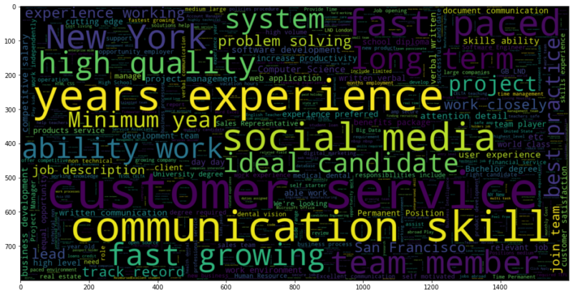
Objective
This project aims to create classifier that will have the capability to identify fake and real jobs.
Employment scam detection will guide jobseekers to get only legitimate offers from companies.
Companies will not get sued or complaints of fraud job offers

Slide 11
Architecture
Problem Definition
Evaluation
Data Collection
Modelling
Data Exploration & Visualisation
Data Pre-Processing/ Mining

Slide 12
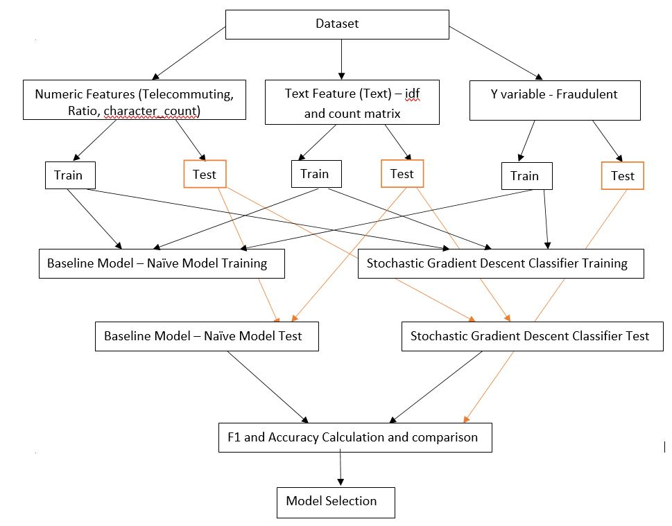
Proposed System

Slide 13
THANK YOU !

